Slide 1


<Name>
<Date>

Slide 2

Outline
Executive Summary
Introduction
Methodology
Results
Conclusion
Appendix

Slide 3
Executive Summary
• Summary of methodologies
○ Collected data from public SpaceX API and SpaceX Wikipedia page
○ Data wrangling
○ Explored data using SQL and visualization
○ Building an interactive map with Folium
○ Building a Dashboard with Plotly Dash
○ Gathered relevant columns to be used as features.
○ Predictive analysis (Classification)
• Summary of all results
○ Exploratory data analysis results
○ Interactive analytics demo in screenshots
○ Predictive analysis results

Slide 4
Introduction
Project background and context
In the current era, commercial space exploration has become increasingly accessible, with numerous companies striving to democratize space travel. Notably, SpaceX stands out as a frontrunner in this endeavor, largely due to its cost-effective approach to rocket launches.
A key factor contributing to this affordability is SpaceX's innovative reuse of the first stage of their rockets. In this project, we aim to predict the successful landing of the Falcon 9 first stage, as it directly impacts the overall cost of a launch. Such predictions hold valuable insights, especially for competing companies seeking to bid against SpaceX for rocket launch contracts.
Problems you want to find answers
- Identifying correlations between various rocket variables and the success rate of first-stage landings.
- Determining optimal conditions that maximize the likelihood of successful landings, thereby enhancing overall mission success rates.

Slide 5

Section 1

Slide 6
Methodology
Executive Summary
Data collection methodology:
•Data was collected using SpaceX API and Web Scrapping form Wikipedia
Perform data wrangling
Transform the results into Training Labels indicating whether the booster landed successfully or unsuccessfully.
Perform exploratory data analysis (EDA) using visualization and SQL
Perform interactive visual analytics using Folium and Plotly Dash
Perform predictive analysis using classification models
Determine the optimal hyperparameters for SVM, Classification Trees, and Logistic Regression.

Slide 7
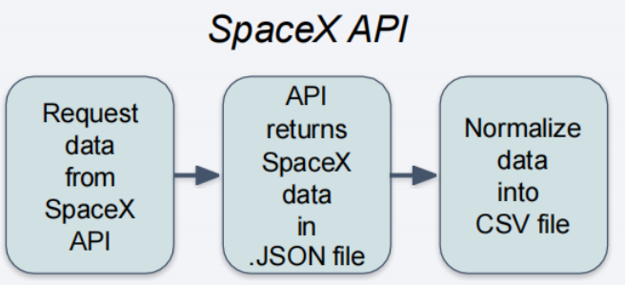
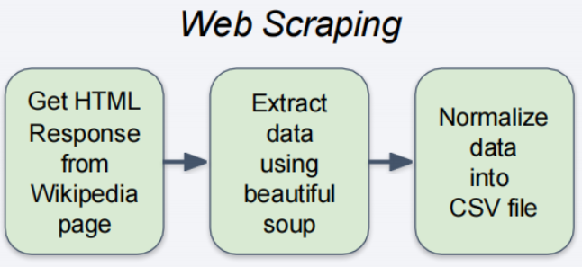
Data Collection
Describe how data sets were collected.
The data collection process includes a combination of API requests from the SpaceX API and web scraping data from a table in the Wikipedia page of SpaceX
You need to present your data collection process use key phrases and flowcharts

Slide 8
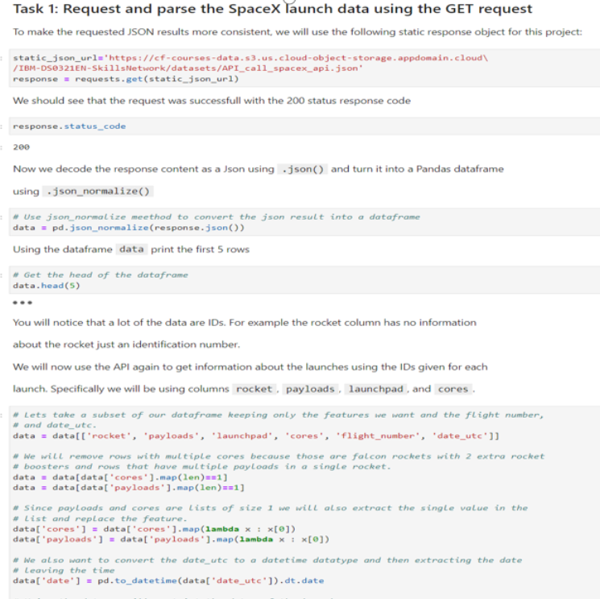
Data Collection – SpaceX API
Present your data collection with SpaceX REST calls using key phrases and flowcharts
Add the GitHub URL of the completed SpaceX API calls notebook
My Github URL:
https://github.com/purpleziyi/DataScience/blob/main/c10/1.%20Complete%20the%20Data%20Collection%20API%20Lab.ipynb

Slide 9
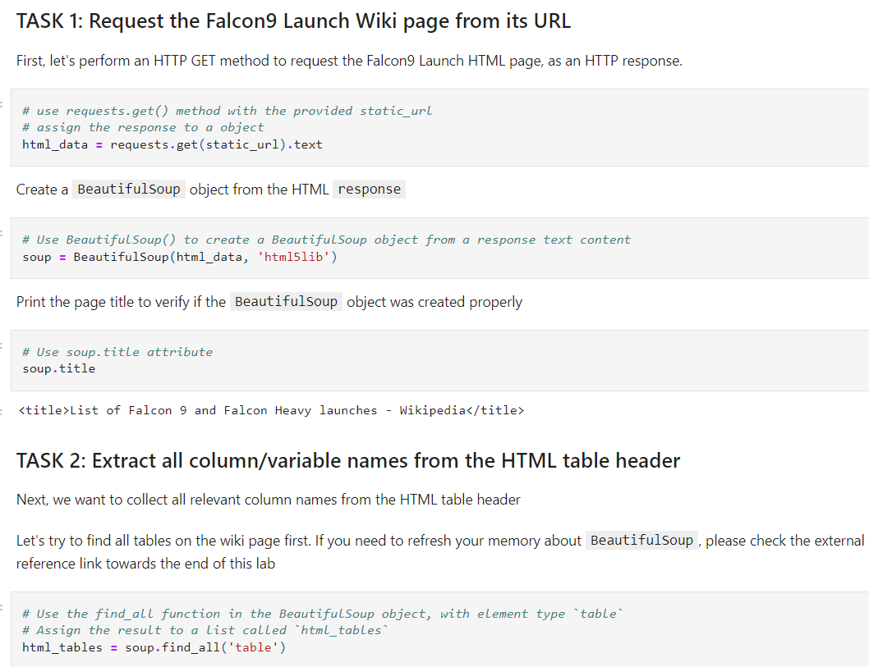
Data Collection - Scraping
Present your web scraping process using key phrases and flowcharts
Add the GitHub URL of the completed web scraping notebook, as an external reference and peer-review purpose
My Github URL:
https://github.com/purpleziyi/DataScience/blob/main/c10/2.%20Data%20Collection%20with%20Web%20Scraping.ipynb

Slide 10
Data Wrangling
I calculated the number of launches on each site and the occurrence of each orbit
I calculated all the outcomes and converted into outcome label (0-1 class)
GitHub URL: https://github.com/purpleziyi/DataScience/blob/main/c10/3.%20Data_wrangling_ZekK73CQ9.ipynb

Slide 11
EDA with Data Visualization
I explored the data by visualizing the relation between ‘FlightNumber’ and ‘PayloadMass’, ‘FlightNumber’ and ‘LaunchSite’, ‘PayloadMass’ and ‘LauchSite’, ‘Orbit’ and ‘ClassMean’, ‘FlightNumber’ and ‘Orbit’, ‘PayloadMass’ and ‘Orbit’, ‘Year’ and ‘ClassMean’
Add the GitHub URL of your completed EDA with data visualization notebook, as an external reference and peer-review purpose
My Github URL:
https://github.com/purpleziyi/DataScience/blob/main/c10/Complete%20the%20EDA%20with%20Visualization%20lab.ipynb

Slide 12
EDA with SQL
• Loading the dataset into the corresponding table in a Db2 database, and executing SQL queries to answer following questions:
○ Displaying the names of the unique launch sites in the space mission
○ Displaying 5 records where launch sites begin with the string 'CCA'
○ Displaying the total payload mass carried by boosters launched by NASA (CRS)
○ Displaying average payload mass carried by booster version F9 v1.1
○ Listing the date when the first successful landing outcome in ground pad was achieved
○ Listing the names of the boosters which have success in drone ship and have payload mass greater than 4000 but less than 6000
○ Listing the total number of successful and failure mission outcomes
○ Listing the names of the booster_versions which have carried the maximum payload mass
○ Listing the failed landing_outcomes in drone ship, their booster versions, and launch site names for in year 2015
○ Ranking the count of landing outcomes (such as Failure (drone ship) or Success (ground pad)) between the date 2010-06-04 and 2017-03-20, in descending order
Github URL:
https://github.com/purpleziyi/DataScience/blob/main/c10/5.%20Complete%20the%20EDA%20with%20SQL%20lab.ipynb

Slide 13
Build an Interactive Map with Folium
I included all launch sites as circle objects and markers, with colors indicating the success of the mission.
Various colored markers provide insights into which launch sites have comparatively higher success rates.
Distances between a launch site and its surrounding areas were computed.
GitHub URL :
https://github.com/purpleziyi/DataScience/blob/main/c10/6.%20Complete%20the%20Interactive%20Visual%20Analytics%20with%20.ipynb

Slide 14
Build a Dashboard with Plotly Dash
I plotted a pie chart showing the total number of launches by a particular sites
I plotted a scatter plot showing the relation between Outcome and payloas mass for a particular booster version
GitHub URL:
https://github.com/purpleziyi/DataScience/blob/main/c10/7.%20spacex_dash_app.py

Slide 15
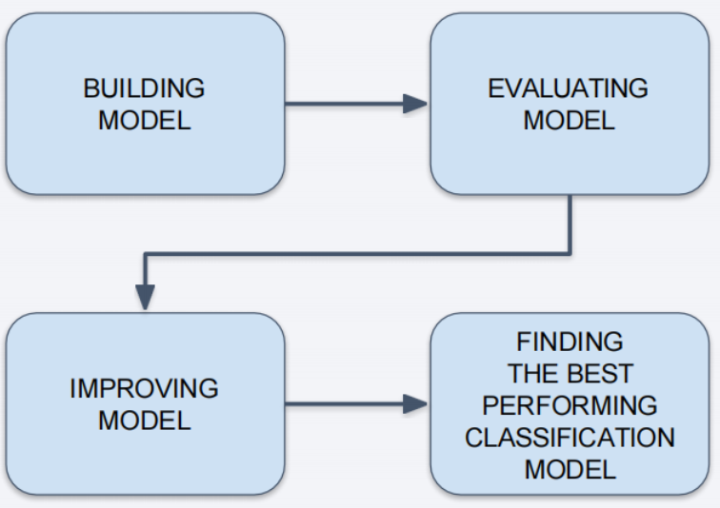
Predictive Analysis (Classification)
• Perform exploratory Data Analysis and determine Training Labels
○ Create a column for the class
○ Standardize the data
○ Split into training data and test data
• Find best Hyperparameter for SVM, Classification Trees and Logistic Regression
○ Find the method performs best using test data
Github URL:
https://github.com/purpleziyi/DataScience/blob/main/c10/8.Machine%20Learning%20Prediction%20lab.ipynb

Slide 16
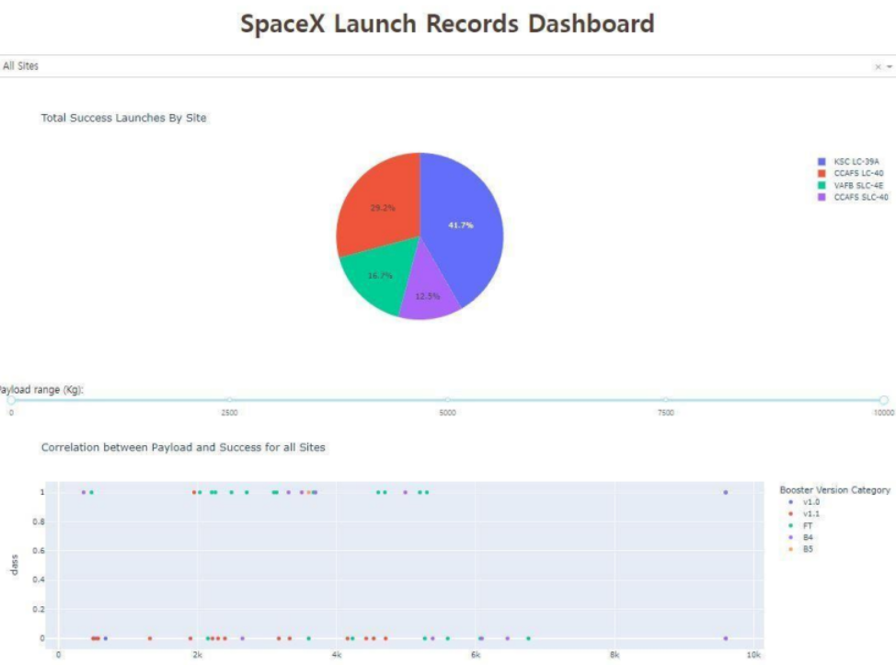
Results
The results of EDA with visualization, EDA with SQL, Interactive Map with Folium, and Interactive Dashboard will be shown in the next slides.
Comparing the accuracy of the four methods, all return the same accuracy of about 83% for test data.

Slide 17

Section 2

Slide 18
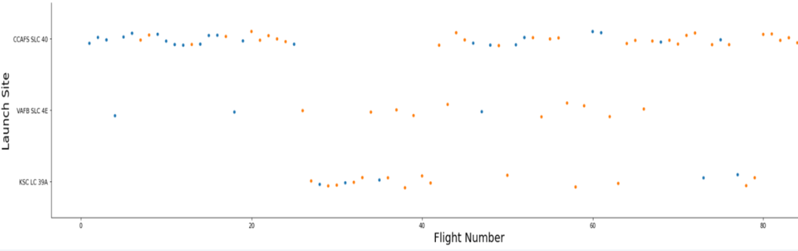
Flight Number vs. Launch Site
The plot indicates a clear trend: as the FlightNumber increases, the success rate at the launch site also increases.

Slide 19
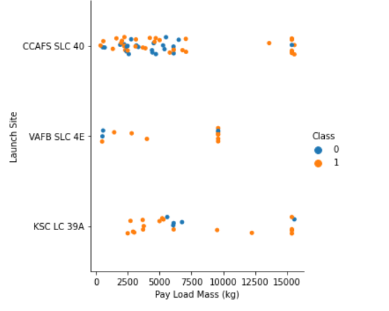
Payload vs. Launch Site
• Class 0 (blue) represents unsuccessful launch, and Class 1 (orange) represents successful launch.
• At first glance, the larger pay load mass, the higher the rocket's success rate, but it seems difficult to make decisions based on this figure because no clear pattern can be found between successful launch and Pay Load Mass.

Slide 20
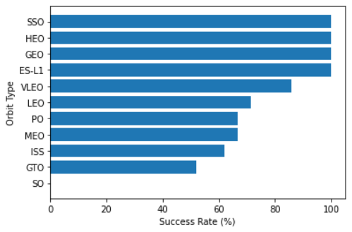
Success Rate vs. Orbit Type
• Orbit types SSO, HEO, GEO, and ES-L1 have the highest success rates (100%).
• On the other hand, the success rate of orbit type GTO is only 50%, and it is the lowest except for type SO, which recorded failure in a single attempt.

Slide 21
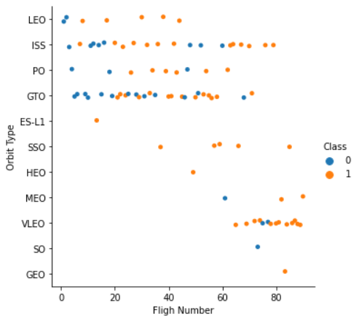
Flight Number vs. Orbit Type
• Class 0 (blue) represents unsuccessful launch, and Class 1 (orange) represents successful launch.
• In most cases, the launch outcome seems to be correlated with the flight number.
• On the other hand, in GTO orbit, there seems to be no relationship between flight numbers and success rate.

Slide 22
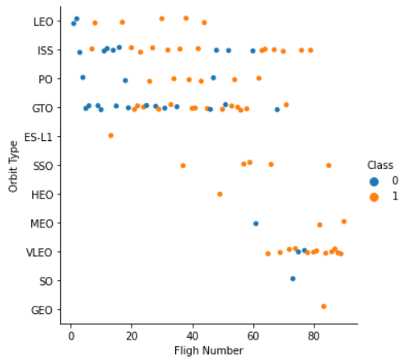
Payload vs. Orbit Type
• The blue color (Class 0) denotes unsuccessful launches, while the orange color (Class 1) denotes successful launches.
• When dealing with heavy payloads, the likelihood of successful or positive landings is higher for Low Earth Orbit (LEO) and International Space Station (ISS) missions.
• Conversely, distinguishing between positive and negative landing rates becomes challenging for missions to Geostationary Transfer Orbit (GTO) due to their close clustering.

Slide 23
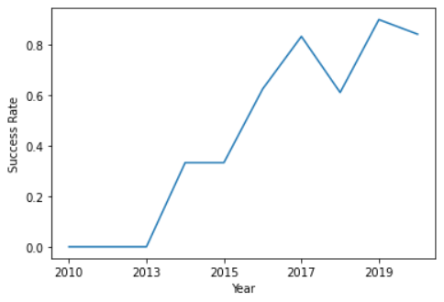
Launch Success Yearly Trend
• Since 2013, the success rate has continued to increase until 2017.
• The rate decreased slightly in 2018.

Slide 24
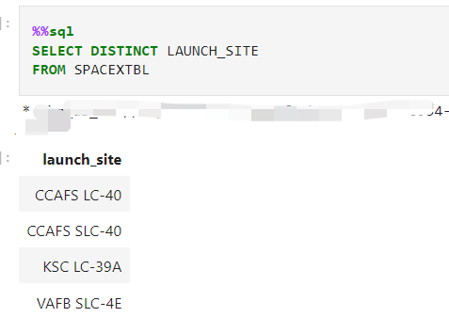
All Launch Site Names
I used DISTINCT keyword to get the distinct launch sites from the dataset

Slide 25
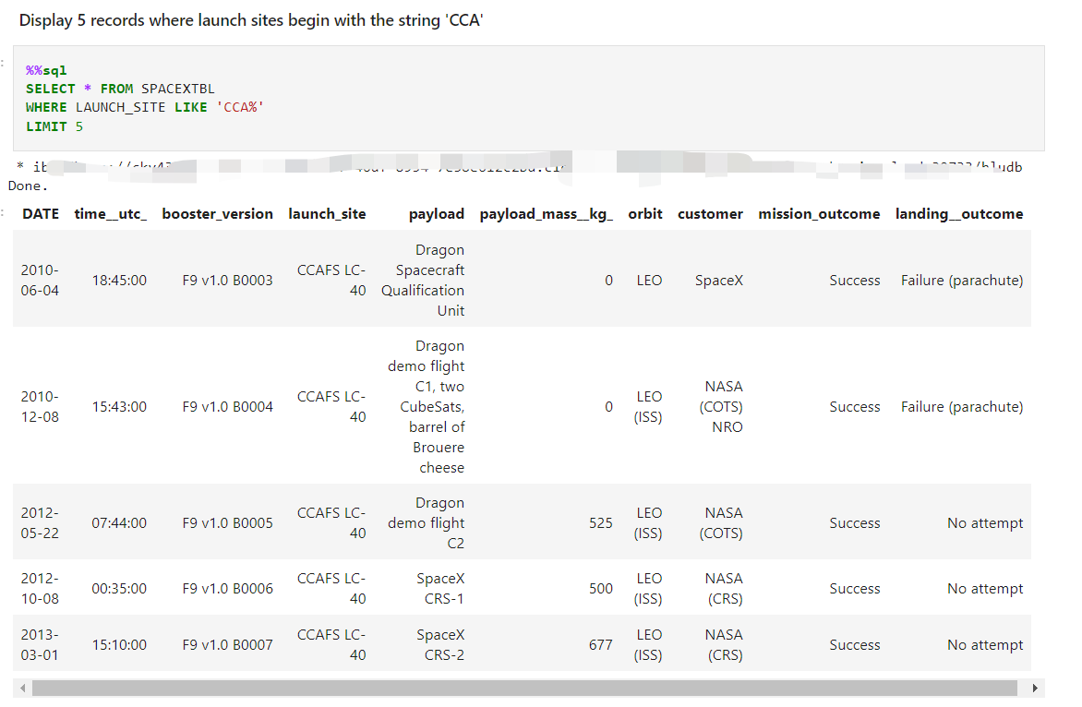
Launch Site Names Begin with 'CCA'
I used WHERE and LIKE keywords to get the 5 records where launch site start with “CCA”

Slide 26
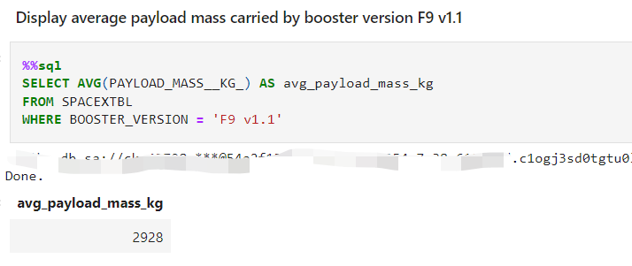
Average Payload Mass by F9 v1.1
I We used AVG inbuild function to get the average of payload mass

Slide 27
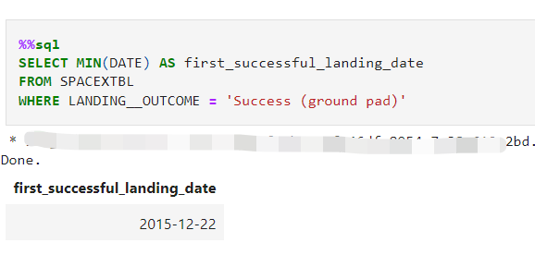
First Successful Ground Landing Date
I We used the MIN inbuild function to get the first date on which the landing outcome in the ground pad was successful

Slide 28
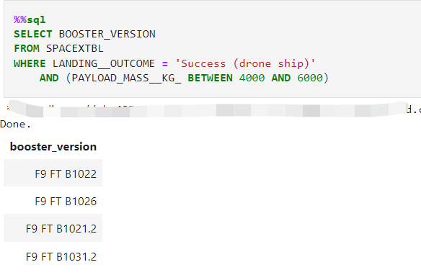
Successful Drone Ship Landing with Payload between 4000 and 6000
I We used WHERE and AND keywords to get the successful drone ship landing with payload between 4000 and 6000

Slide 29
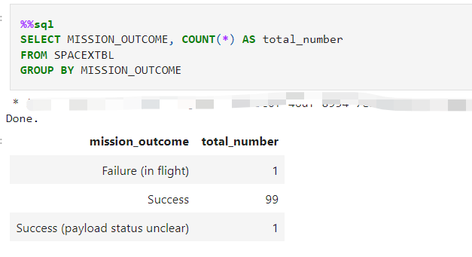
Total Number of Successful and Failure Mission Outcomes
I used the COUNT inbuilt function and grouped by mission outcome column using GROUP BY keyword

Slide 30
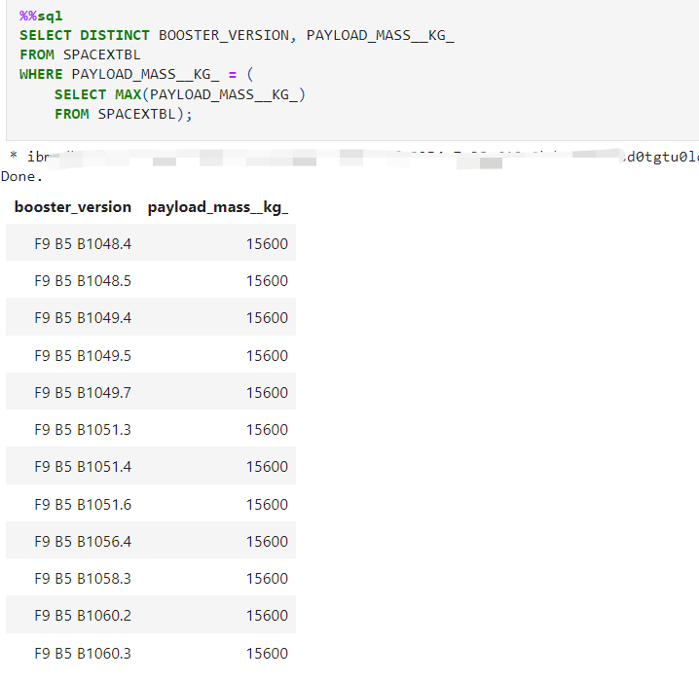
Boosters Carried Maximum Payload
I We used subquery to get the names of boosters carried maximum payload

Slide 31
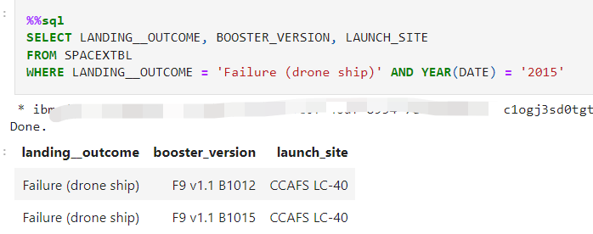
2015 Launch Records
I used LIKE and AND keywords in WHERE clause to get the results

Slide 32
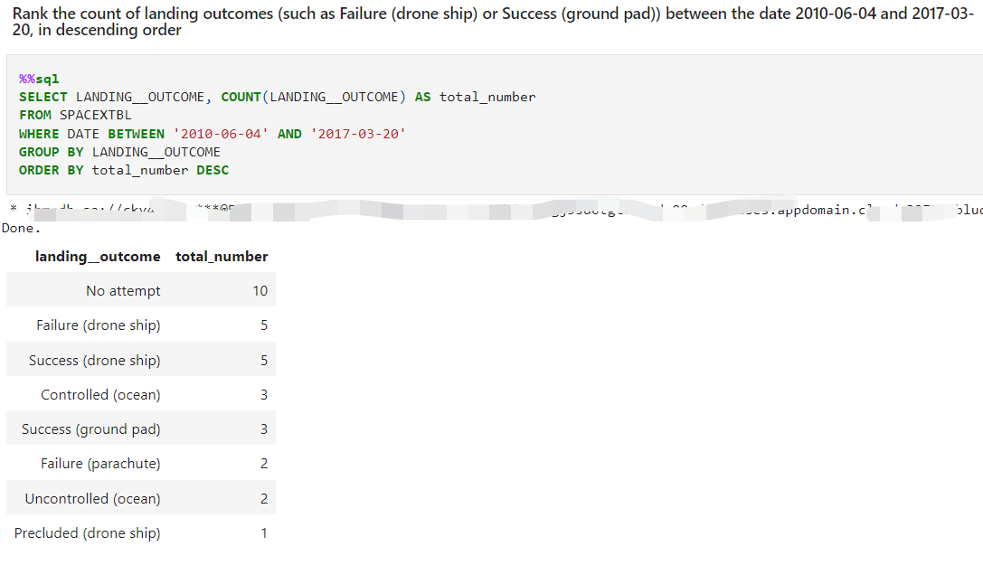
Rank Landing Outcomes Between 2010-06-04 and 2017-03-20
I used AND keyword in the WHERE clause and the further result is grouped by landing outcome and sorted by the count

Slide 33

Section 3

Slide 34
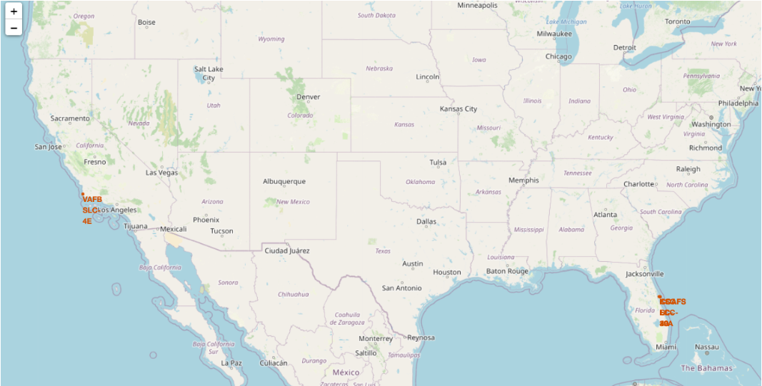
All Launch Sites’ Locations
From this map, we can see that all launch sites are on the United States of America’s coasts

Slide 35
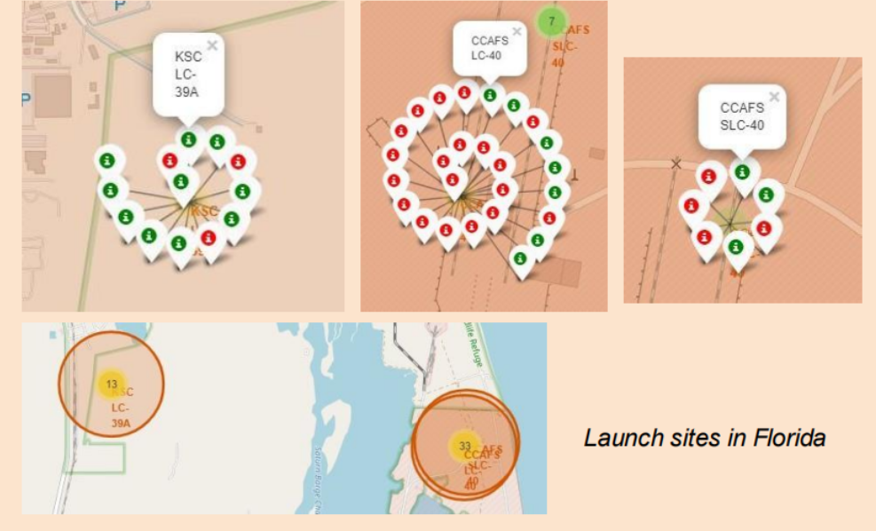
Color Markers Launch Outcomes
Green Markers shows a successful mission and Red Markers shows a unsuccessful mission

Slide 36
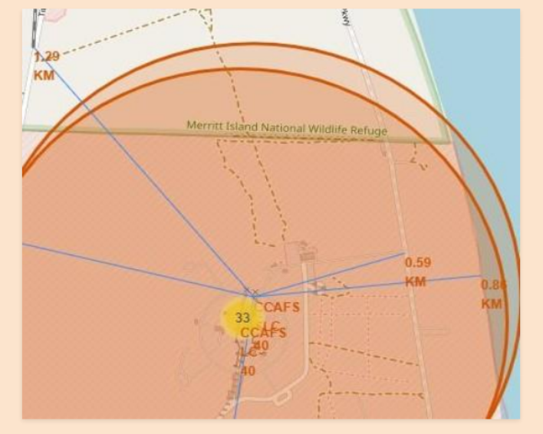
Proximities of Launch Sites
• It can be found that the launch site is close to railways and highways for transportation of equipment or personnel, and is also close to coastline and relatively far from the cities so that launch failure does not pose a threat.

Slide 37

Section 4

Slide 38
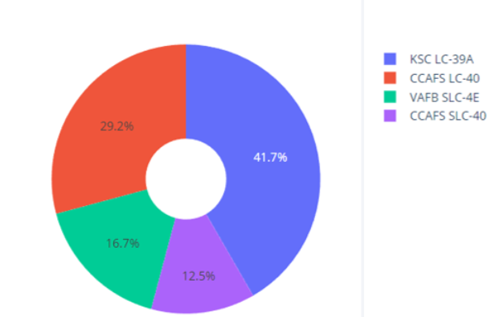
Pie Chart of Launch Success for All Sites
From the pie chart, it is clear that KSC LC-39A has the most successful missions

Slide 39
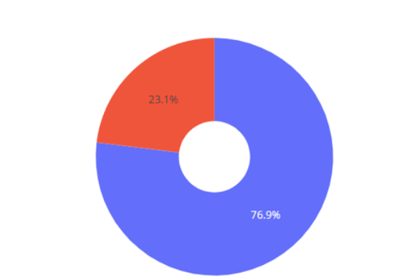
Pie Chart of Highest Success Rated Site
From the pie chart, it is clear that KSC LC-39A has 76.9% success rate

Slide 40
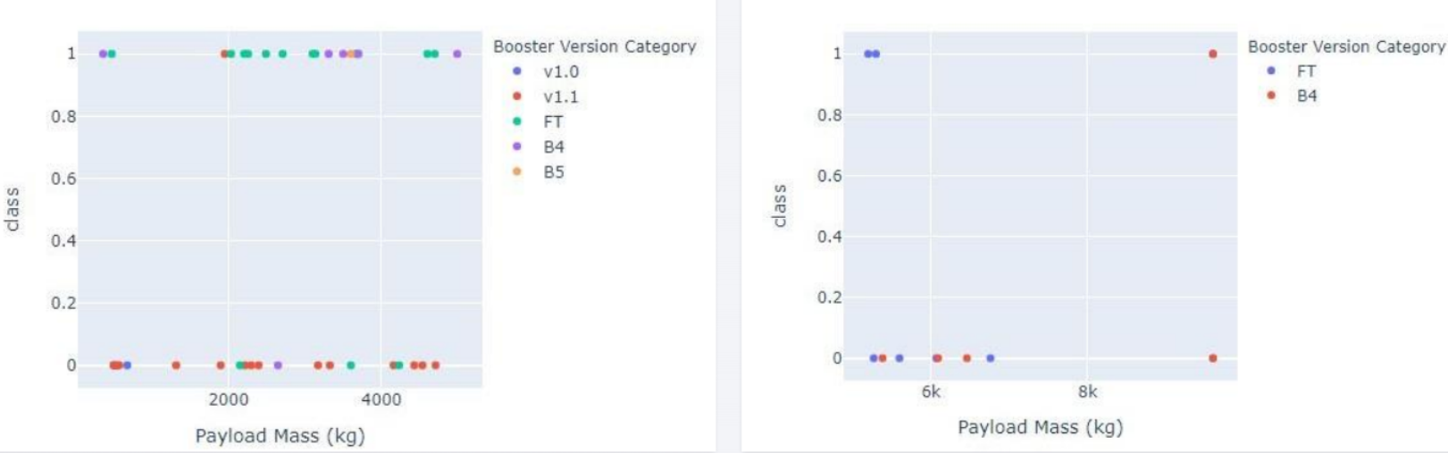
Payload vs. Launch Outcome Scatter Plot for all sites
• These figures show that the launch success rate (class 1) for low weighted
payloads(0-5000 kg) is higher than that of heavy weighted payloads(5000-10000 kg).

Slide 41

Section 5

Slide 42
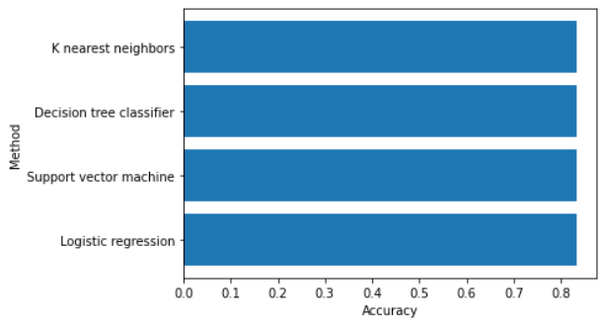
Classification Accuracy
From the bar chart, it is clear that Decision Tree Classifier has the highest accuracy.

Slide 43
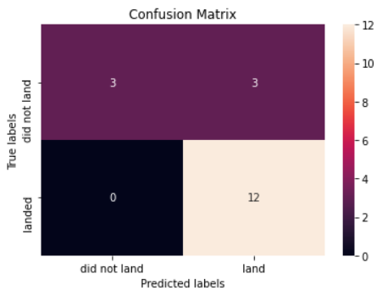
Confusion Matrix
From the Confusion Matrix of Decision Tree Classifier, it is clear that it is very robust when class is 1. The model struggles with False Positives

Slide 44
Conclusions
From this study, we can conclude that
Larger the Flight Number greater the success rate
Mission success rate is increasing from 2013 till 2020
KSLC-39A has the highest number of launch successes and the highest success rate among all sites.
The Decision Tree Classifier is the best model to predict the success of the mission
The launch success rate of low weighted payloads is higher than that of heavy weighted payloads.

Slide 45
Appendix
Include any relevant assets like Python code snippets, SQL queries, charts, Notebook outputs, or data sets that you may have created during this project

Slide 46


